Slide 1
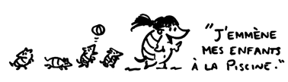
Un petit test
Comment dit-on…
to bring
to fetch
to take people
things???/people
Avec exemples

Slide 2
French menu: http://www.copainsgourmands.com
French video on food and drink: http://www.bbc.co.uk/languages/french/talk/eatdrink/
Homework video: http://www.ashcombe.surrey.sch.uk/curriculum/modlang

Slide 3

De quoi s’agit-il?
http://curriculum.qca.org.uk/key-stages-3-and-4/curriculum-in-action/casestudieslibrary/case-studies/Getting_passionate_about_history__in_French.aspx

Slide 4
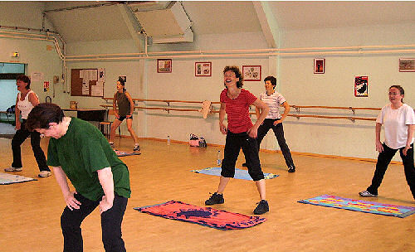

Slide 5

AT4
ECRIRE

Slide 6
AT4
La tâche?
Evaluation du niveau (assessment levels)
Les étapes
KS3
KS4

Slide 7
References
http://www.standards.dfes.gov.uk/keystage3/downloads/cs_en_fs_writing_toolkit.pdf
http://www.ncaction.org.uk/subjects/mfl/profile.htm
http://curriculum.qca.org.uk/key-stages-3-and-4/assessment/index.aspx

Slide 8
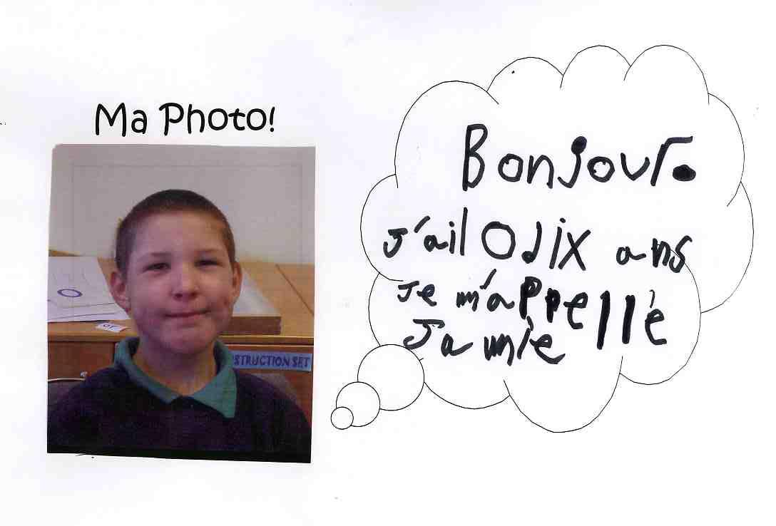
Jamie AT3 niveau?

Slide 9
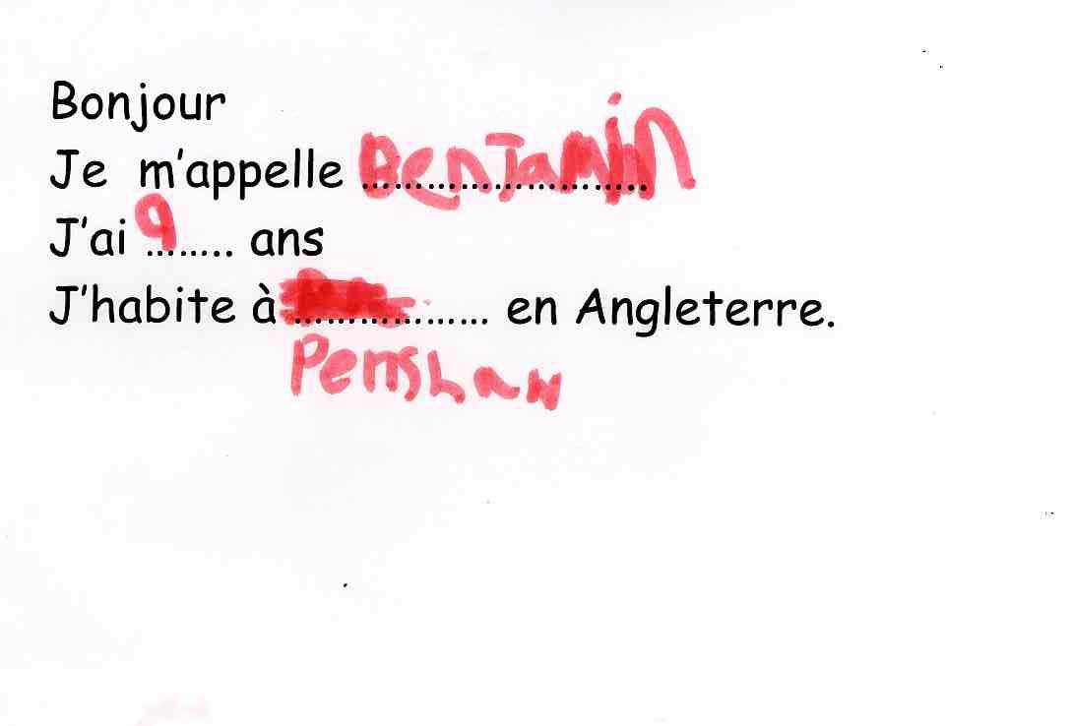
Et Benjamin..?

Slide 10
Quelques liens
http://joedale.typepad.com/integrating_ict_into_the_/2007/02/effectiveness_o.html
http://64.233.183.104/search?q=cache:Rr6ZyV5QiisJ:https://www.pgfl.org.uk/Documents/Sample%2520Module%2520A%2520Assignment.doc+mini+whiteboards+%2B+MFL&hl=en&ct=clnk&cd=6&lr=lang_en|lang_fr&client=safari

Slide 11
Devoirs
1.individuellement
Débat:Préparez-vous à partciper.
Avantages et desavantages de la technologie en classe de langues.
2. En groupe
Apportez un exemple d’une application technologique (AT1,2,3,4,)

Slide 12

chanter
http://www.vivenoel.com/contes/chansons/vent.htm
http://www.tv5.org/TV5Site/tivi5/page-11-Paroles_de_chansons.htm

